Slide 1
Visual Question Answering
Group #16 yangyiyy@bu.edu qilongw@bu.edu

Slide 2
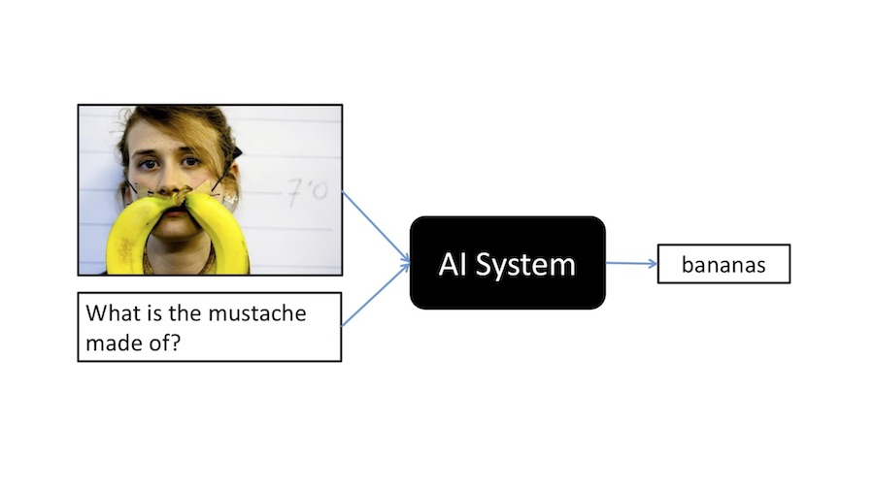
1.Application-Product mission
Input: An image and a text question about the image
Output: An answer for the question

Slide 3
1.Application-Users
Application of VQA: Giving medical advices, helping blind people, used for online shop AI service and so on.
Our focus: Mainly on helping blind people.

Slide 4
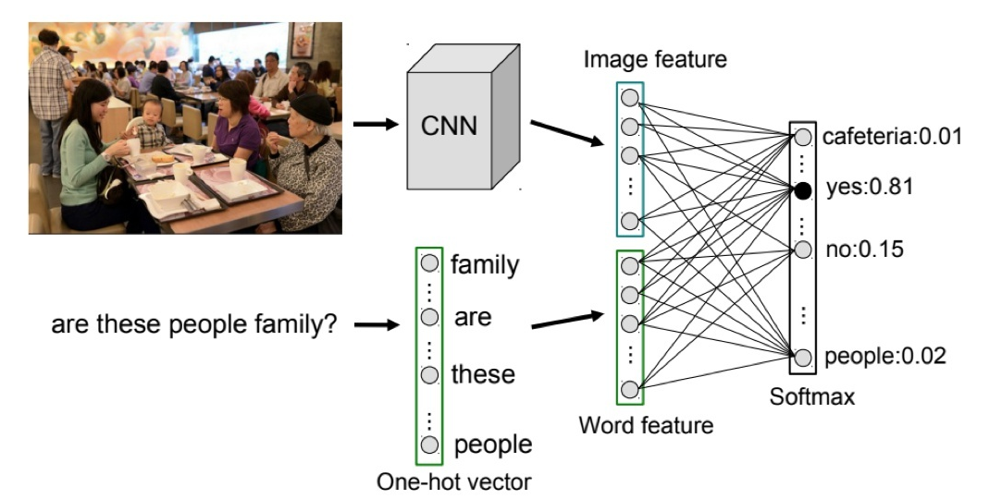
2.Literature Method-Joint Embedding
The purpose of joint embedding is to learn the representation of CV and NLP tasks in common space. It is the basis of most VQA methods.
The image representations used are generally pre-trained CNNs on object recognition, and text representations are generally pre-trained word embeddings on large text corpora, and then the embedding of words in the problem is sent to RNN to solve variable-length sequences.

Slide 5
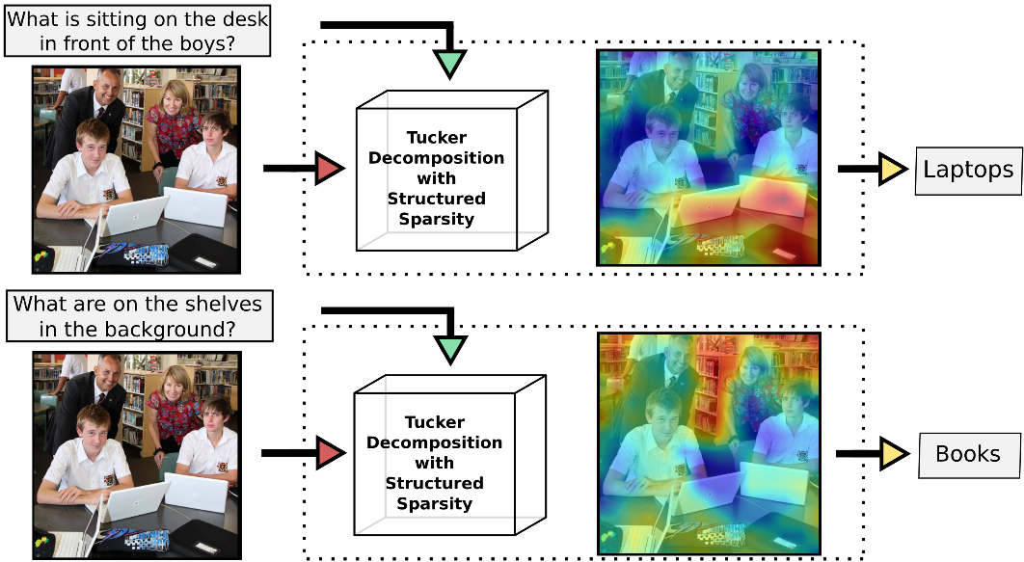
2.Literature Method-Attention
The attention mechanism uses local features and allows the model to give different weights in different regions. In VQA, we focus on the regions related to the question.

Slide 6
2.Literature Method-Knowledge based
VQA usually requires prior knowledge, such as "how many mammals are in the picture", so joint embedding is flawed: it can only acquire the existing knowledge in the training set, and it is impossible to cover all situations in the real world. So one solution is to combine the reasoning process with the knowledge base.

Slide 7
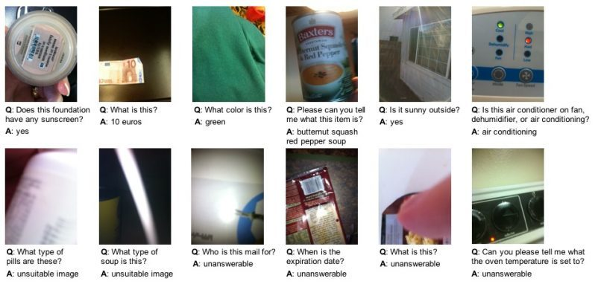
3.User Story
Blind people may use our app to distinguish the type of pills.
Blind people may use our app to know the expiration date of food.
Left figure shows a dataset from a real blind people. As shown in the figure, blind people may face to many different occasions that they need to know the information in pictures but they can not.

Slide 8
4.Our Technology
Purpose: Helping the blind to recognize items in their lives.
Development environment: pytorch.
4 GPUs, 64GB memory, and PyTorch v1.0.1 for Python 3
Method: ban-VQA
-Method Advantage: High accuracy in open source (70.35%)
APIs maybe used: Speech-to-text (Google), Colab (Google), Google Cloud Vision.

Slide 9
5.Next Sprint Goals
Run the code on google colab.
Try to adjust dataset to the blind vqa dataset and add a new classification to deal with the low-quality pictures.

Slide 10
Thanks for listening

